Slide 1

Beverage market in Thailand
A brief market analysis

Slide 2
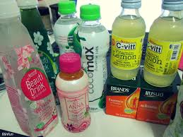
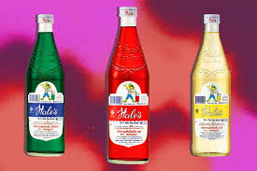
Executive Summary of the Thai beverages market
The beverage market in Thailand comprises of alcoholic and non-alcoholic segments that showcases a wide range of product line. The alcoholic segment includes spirits and beers and the non-alcoholic segment includes bottled water, carbonated drinks, sports and energy drinks, juice, Ready-to-drink coffee, ready-to drink teas and other health juices.
Despite robust economic growth, the Thai beverages market is expected to witness average growth in the period 2019-2021. Of late, the important market segments of beer and spirits, energy drinks, carbonated drinks have become saturated due to governmental preventive measures to decrease consumption of harmful products including beverages with high sugar content and alcohol drinks.
Market Overview
The Thai beverages market is highly fragmented dominated by established domestic players, other small players and international players.
The major segments of the Thai beverage market are bottled water, carbonated drinks, energy drinks, beer and spirits, and these together accounted for 87% of the industry’s value between 2012 and 2018.
Of late, the Thai government has introduced tax incentives and easy visa procedure to attract more foreign investments.
Market Trends and Drivers
The increase in sales of beverages is due to urbanization, consumer changes to healthier lifestyle and higher rates of eating out among youngsters.
Social Media posts on beverages drives e-commerce and most Thai consumers maintain brand loyalty
High growth in areas that offer varied experiences.
Majority of the convenience stores influence shopping behavior.
Alcoholic market players: Boon Rawd Brewery, Thai Beverage, Ruang Khao, Phai Thong, Maekhong, Hong Thong and other such players.
Non-alcoholic market players: Coca Cola Thailand, Pepsi co Thailand, Sermsuk, Sakol Beverage company, Nestlé Thai, Singha corporation, Ichitan group, Osotspa and other such players
Major Players in the alcoholic and non-alcoholic market

Slide 3

Thai Consumer Insights
Buying behavior
Thai consumers have sophisticated preferences emphasizing a lot on product attributes other than
the prices across the categories. Taste, safety, health and trust are a few important product attributes
that consumers seek out in beverages.
Brand preferences
Thai consumers across all income groups favor well-established domestic brands catering to local taste
for non-alcoholic beverages.
Communication
channels
Promotions on Television and in-store influence consumers’ buying choices.
Of late, Consumers research on the digital platforms (Instagram, facebook, blogs, company
websites and apps ) before purchasing any product.
Buying Channels
Modern trade channels are preferred modes of buying in cities such as Bangkok and Chiang Mai
Typically, consumers prefer visiting hypermarkets, supermarkets, mom and pop stores and minimarkets
for beverages.

Slide 4
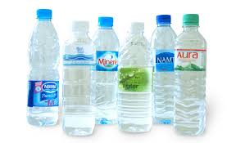
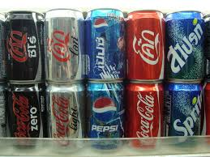
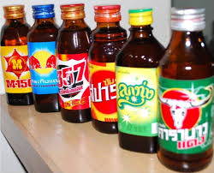
Structure of Thai Beverage Industry (Non-Alcoholic drinks)
Non-alcoholic beverages
Foreign investments contributed to immense growth leading to a surge in investments. For instance, Coca Cola and Polaris water bottling plants. Later the Thai government started supporting the production of non-alcoholic drinks based on local consumer demand.
There are a large number of beverages available in the Thai market with an impressive product line in the individual segments.
Bottled water
The advancements in machine technology has made sure that high standards are being maintained (at low unit costs)when purifying water. As a result, there are many new players making their presence felt in the market.
Around 60% of the bottled water segment is dominated by top players that enjoy economies of scale and superiority in terms of distribution and marketing.
Prominent players in this segment are Coca Cola Thai, Nestle Thai, Singha Corporation and Sermsuk
Carbonated drinks
The carbonated drinks segment exhibits oligopoly market structure as new entrants have to invest a lot to maintain plant machinery and achieve economies of scale.
Prominent players in this segment are Sakol Beverage Company, Pepsi Cola Thai, RJ Group, Coca Cola Thailand and Sermsuk.
Energy drinks
The energy drinks segment is oligopolistic in nature and top market players account for a major share in this segment. They design innovative marketing strategies to preserve their market share from new players.
Prominent players in this segment include Carabao group, TC Pharmaceuticals and Osotspa
Notes:
Micro renewables

Slide 5
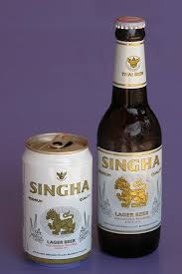
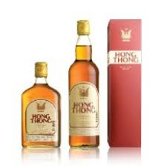
Structure of Thai Beverage Industry (Alcoholic drinks)
Alcoholic beverages
Beer and Spirit alcoholic beverages available in the Thai market with an impressive product line in the individual segments.
Beer
The Thai beer market is dominated by Thai beverage and Boon Rawd Brewery. These companies account for a major market share with respective to capital base and distribution channels.
Spirits
The spirits beverage market is highly regulated by authorities and it is relatively difficult for new players to gain a foothold in the market. As a result, ThaiBev has been dominating the spirits segment with an interesting product line.
A few brands selling white spirits include Bangyikhan, Chao Praya, Mee Khao, Niyom Thai and others. Brown Spirits comprise of Sang Som, Crown 99, Maekhong and so on. Mixed spirit brands include Siang Chun and Sua Dum.
Notes:
Micro renewables

Slide 6
Thai Beverage Industry Dynamics
Beverage Market (2017) by value (%)

Slide 7
Thai Beverage Industry Dynamics
Beverage Market (2017) by volume (%)

Slide 8
Market Trends (Non-alcoholic drinks)
Plant-based ingredients in beverages
Young adults in Thai metros associate with products that are made with plant-based ingredients. Any beverage that uses fruits, vegetables, seeds, herbs and grains as their main ingredient is popular with the urban crowd. When new products were launched in 2018, a quarter featured vegetables and the rest consisted of nuts as the main ingredients. Most beverage manufacturers receive tax exemption for promoting beverages sweetened with natural ingredients.
For instance, Slin drink, a beverage that was launched in Thailand is made from natural ingredients and mostly targeted health-conscious women.
Increasing small-sized families and sustainable consumption
As the number of the small-sized family is growing, the average Thai household size has decreased rapidly. As a result, beverage manufacturers in Thailand are designing portion-controlled packs for smaller households. Convenience and costs are other two main attributes featuring in product and packaging design of the beverages.
Sustainable consumption is one of the emerging trends in Thailand and efforts are being taken by manufacturers to design eco-friendly packaging.
Higher purchasing power, low price sensitivity
Rapid urbanization in Thai metros has led to consumers from higher income groups being selective about products on display. Thai consumers are brand loyal with quality and taste being important attributes. For that reason, consumers are willing to pay a higher price for a product. To meet and satisfy consumer demand, beverage manufacturers are ready to offer a wide range of products at various prices.

Slide 9
Market drivers (Non-alcoholic drinks)
Increasing demand for premium functional drinks is driving beverage sales
Of late, Thai consumers have become health conscious and are concerned about their nutritional intake. For that reason, functional drinks have become very popular and this demand is expected to drive market growth in this segment. Due to growing preference for drinks that focuses on the customers well-being, manufacturers have used collagen and hyaluronic acid as the main ingredients to improve the skin’s smoothness and anti-aging process. For instance, Sappe beauti drink, enriched with collagen and vitamin C aids in minimizing pores and tightens skin.
Social media advertising to drive beverage growth in Thailand
Beverage manufacturers use multiple media channels to market their products and reach out to consumers. Advertisements on television, radio and billboard hoardings are very common in Thailand. However, promotions through facebook videos and advertisements have garnered more user engagement. Thai Beverage manufacturers approximately spend $21 million dollars in marketing their products through digital medium. For example, Cha Cha Thai beverage drink manufacturers market their product as a novel experience by making ad videos to target young adults.
High demand for Thai beverages is driving sales for Thai manufacturers in other Asian countries
In order to have unique experiences , consumers in other asian countries are flocking to stores to sample the varied Thai beverages on display. Apart from the decent prices, these beverages are manufactured with natural ingredients with no added preservatives. As these products are being marketed as refreshing drinks offering premium quality natural content, a growing number of health-conscious consumers are switching to these products. For instance, based on consumer demand, the widely popular, Dum Dum Thai drinks, opened their outlets in Singapore in 2018. Owing to their unique taste, these drinks have become Singaporeans’ lifeline during peak humid weather.

Slide 10
Brand Strategy and Initiatives (Non-alcoholic drinks)
Thai beverage sales increase after successful stint in South Korea
Because of the variety and quality of Thai beverages, they are very popular across the South east asian region. One of Thai beverage manufacturers, Healthful Co, introduced ‘Nice Dream’- a functional beverage to counter insomnia and improve sleep quality. This drink was first released in the Thai market two years ago and the firm decided to introduce the same drink in the South Korean market through their e-commerce platform, Wadiz.
The drink was an instant hit in the South Korean market and the company used the overseas recognition to increase sales of the brand in the domestic market.
Strategic partnerships to expand brand portfolio
As consumers across Thailand have moved towards innovative and healthy products, it has become imperative for beverage brands to cater to customer requirements. For instance, Ajethai Co Ltd, has launched a range of innovative health drink products for Thai consumers. Moreover, to increase their customer base, Ajethai has partnered with Makro, the cash- and- carry wholesalers for exclusive business operations in Thailand. Under this partnership, the company has released two new soft drink flavors, BIG Bubble Gum and BIG Blue Hawaii.
Foreign companies collaborate with Thai companies to consolidate market position
Japanese beverage manufacturers Calpis partnered with Thailand’s Osotspa to produce softdrinks called ‘Calpis Lacto Freshy’, made from fermented milk and marketed under the Calpis Lacto brand.
This partnership has helped the Japanese brand to leverage Osotspa’s distribution network to increase brand recognition in Thai market.

Slide 11
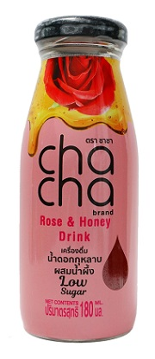
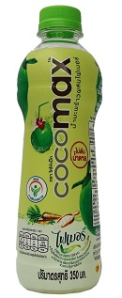
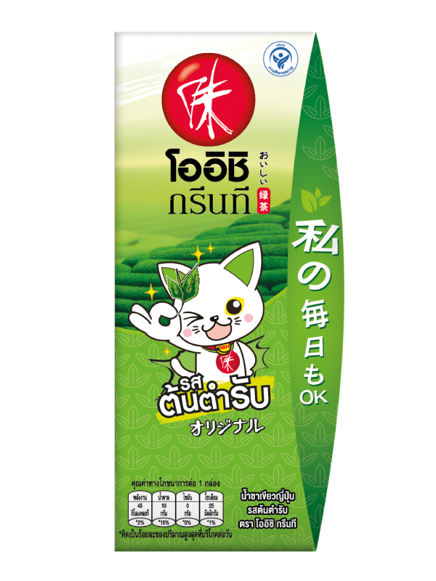
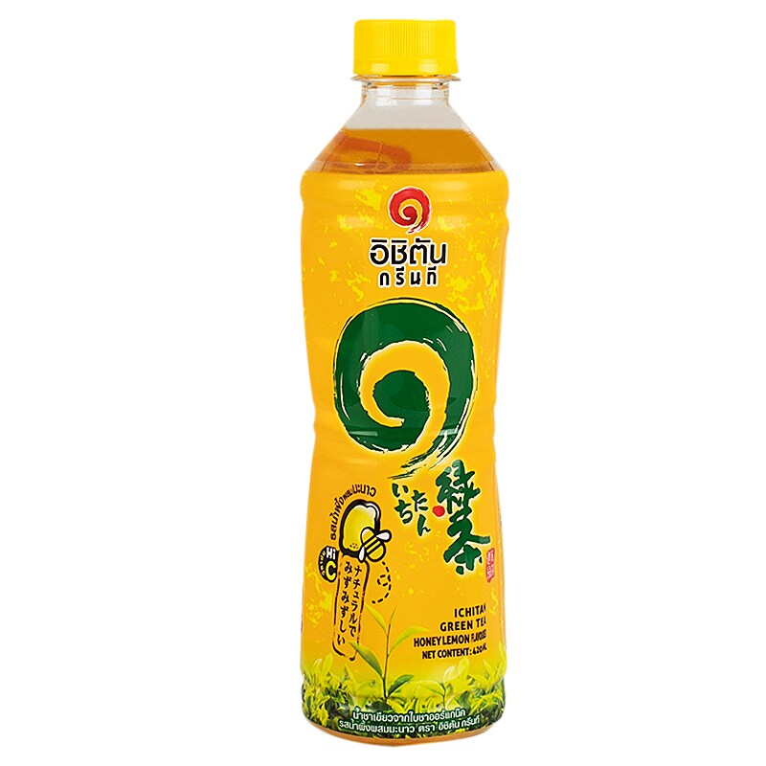
New Product Concepts in Thailand Beverage Market
Brand: Cha Cha low sugar rose and honey drink
Thai Consumers are seeking out intense sensory experiences in products with no preservatives. In the process, the company has concocted a visually pleasing drink that mixes juice with honey and rose water for customers looking for novel experiences.
Brand: Cocomax coconut drink
Thai Consumers have become very health conscious and prefer having beverages with natural ingredients. This drink is refreshing and enriched with essential electrolytes. It is manufactured with natural inulin fibre that is need to stimulate the excretory system.
Trend: Health Conscious
Trend: Novel experiences
Brand: RTD green tea(Ichitan group)
Keeping in mind consumers’ choices, Ichitan group has introduced a green tea with natural ingredients. This RTD green tea is perceived to be a top quality product with unsweetened contents.
Brand: RTD green tea(Oishi group)
Oishi group sources ingredients from high quality suppliers. The company’s beverage manufacturing plant uses modern technology such as cold aseptic filling, to ensure premium quality and taste. The group offers these drinks in many flavors catering to frequent customer demand.
Trend: Technology
Trend: Premium quality

Slide 12
Appendix
National Food Institute
https://www.ncbi.nlm.nih.gov/pmc/articles/PMC6003000/
https://www.bangkokpost.com/business/1611822/thailands-digital-advertising-poised-for-growth
https://www.irplus.in.th/Listed/ICHI/calendar/relate_info/ICHI_Manulife_2Q18.pdf
http://investor.osotspa.com/en/news-events/set-announcements?page=4
https://www.foodnavigator-asia.com/Article/2019/01/29/Juice-boost-Thailand-considers-tax-exemptions-for-drinks-with-higher-fruit-and-veg-content
https://www.campaignlive.co.uk/article/thailands-ichitan-beverage-brand-taps-new-thirst-health/1325418

